Slide 1
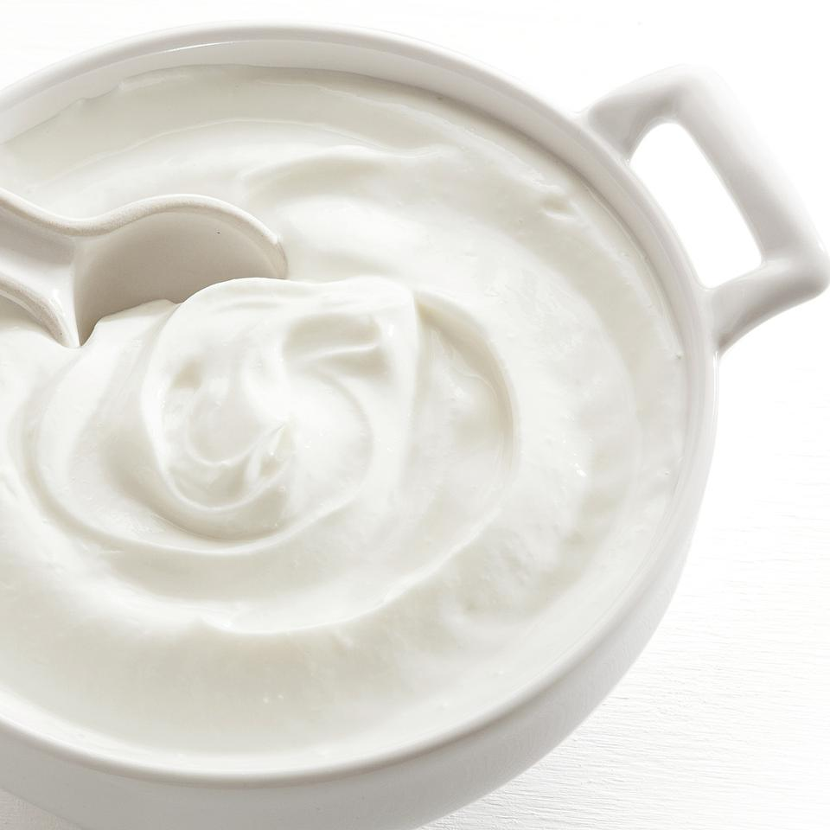
What Attributes Should a Popular Greek Yogurt Have?
Presented by Team F:
Wanfeng Deng, Tianrun Gu, Maximilian Johnson, Jingwei Li
Project: Case 2 Greek Yogurt
Section: GBA 424 8:30 – 10:00
Date: 11/9/2020

Slide 2
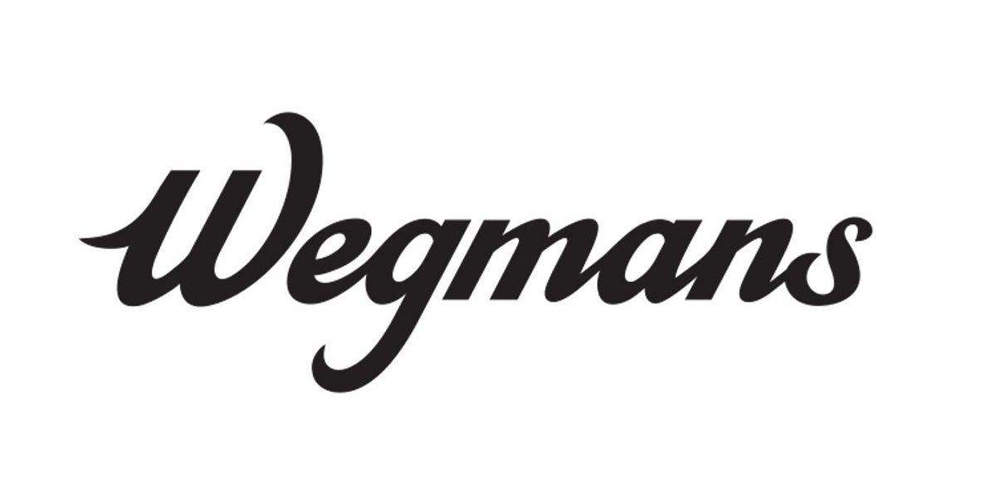





Team F
|
Wanfeng Deng
Tianrun Gu
Maximilian Johnson
Jingwei Li

Slide 3
Is our sample representative?
|
Chi-square test:
The sample does not match the population on gender
Difference is not economically meaningful
Limitation imposed on the study
Face validity Check:
Responses appeared to be reasonable with no outliers
Percentage | Female | Male
Population | 0.78 | 0.22
Sample | 0.89 | 0.11
Sample
Key Attributes
Competitors
Magazine & Recipe
Recommendation
Notes:
One sentence to mention bias, complete observations, 135 NA, e

Slide 4
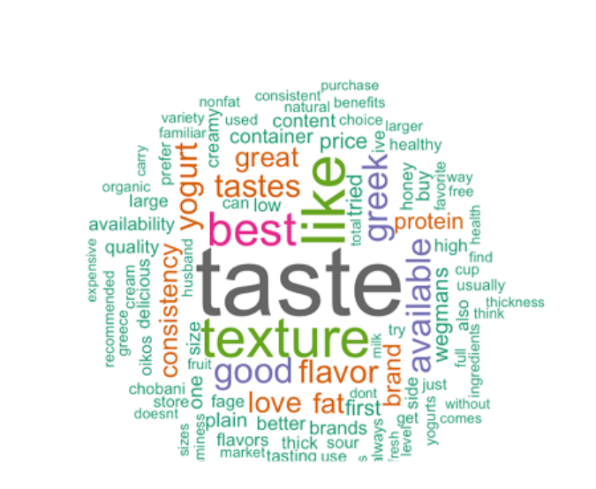
|
Key Attributes
Shrink Attributes into 2 Main Groups
Health
Protein level
Calories level
Fat level: 0% & 2% take 85% of market
Taste and Texture
1st Reason Why Choose a Brand
Source: Wegmans Greek Yogurt Survey
Sample
Key Attributes
Competitors
Magazine & Recipe
Recommendation

Slide 5
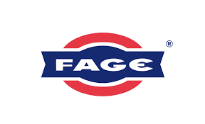


|
Competitive Landscape
Competitor’s Advantages:
Taste and texture
Healthy, taste, and price
Side by side cup, fruit on the bottom, and healthy
Wegman’s Potential Advantages:
Advantage:
Low price
Disadvantage:
Brand impression
Sample
Key Attributes
Competitors
Magazine & Recipe
Recommendation
Notes:
The three biggest brand in the the greek yogurt mkt.

Slide 6
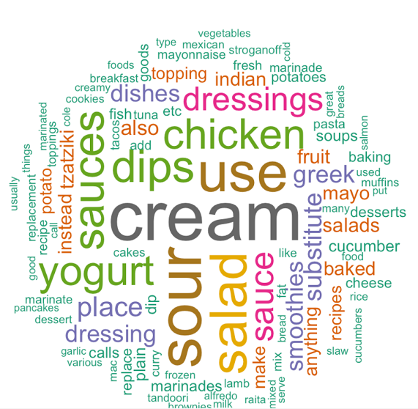
|
Magazine & Recipe
What Consumers Cook with Greek Yogurt
Percentage:
Use Greek yogurt for cooking: 49%
Don’t use Greek yogurt for cooking: 51%
Occasion:
Most for dinner, dessert, and lunch
As snack or afternoon tea
Source: Wegmans Greek Yogurt Survey
Sample
Key Attributes
Competitors
Magazine & Recipe
Recommendation

Slide 7
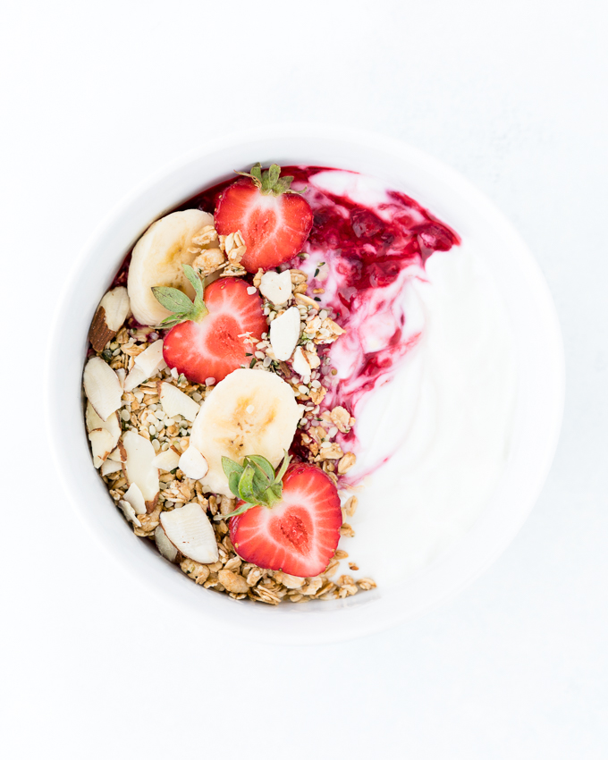
|
Recommendation
Important Attributes:
Health
Fat content
Taste and texture
Competitive landscape:
Competitors: Chobani and Oikos
Advantage:
Lower price
Magazine recommendation:
Frequency: dinner, lunch, and dessert
Recipe: sour cream, chicken dips, and salad
Sample
Key Attributes
Competitors
Magazine & Recipe
Recommendation

Slide 8
Q&A
Wanfeng Deng
Tianrun Gu
Maximilian Johnson
Jingwei Li

Slide 9
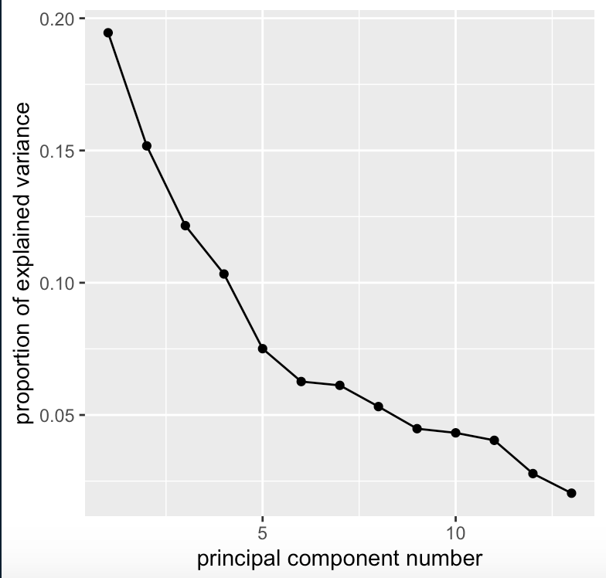
Appendix A - Elbow Rule
|

Slide 10
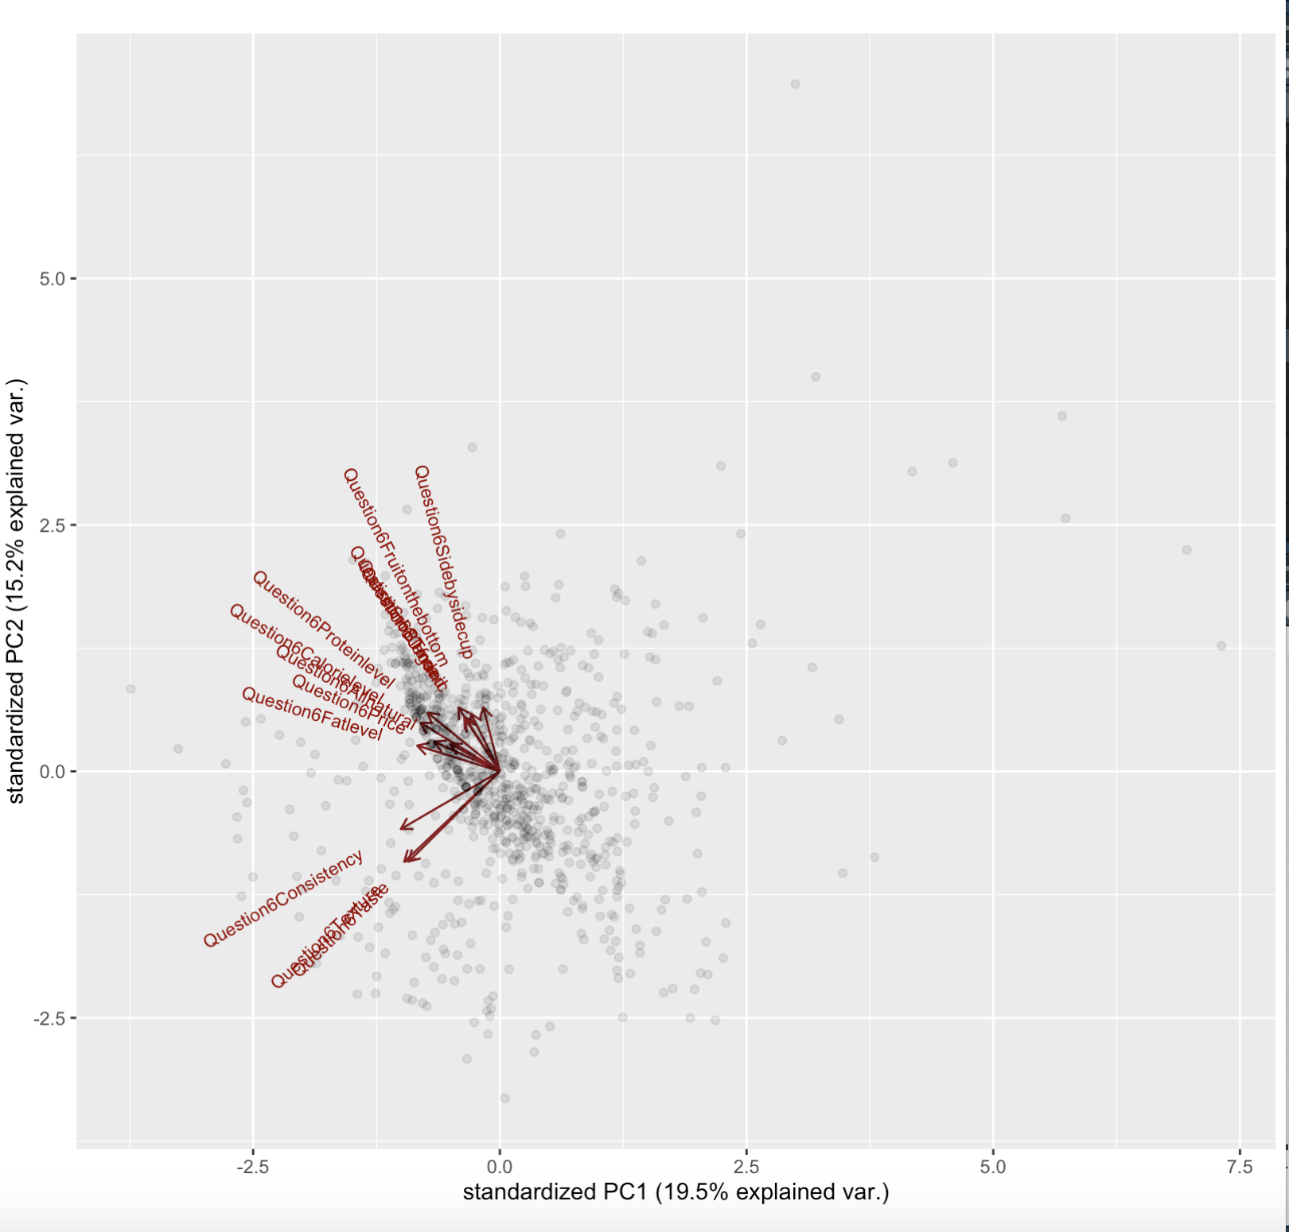
Appendix B - Key Attributes for Greek Yogurt
|

Slide 11
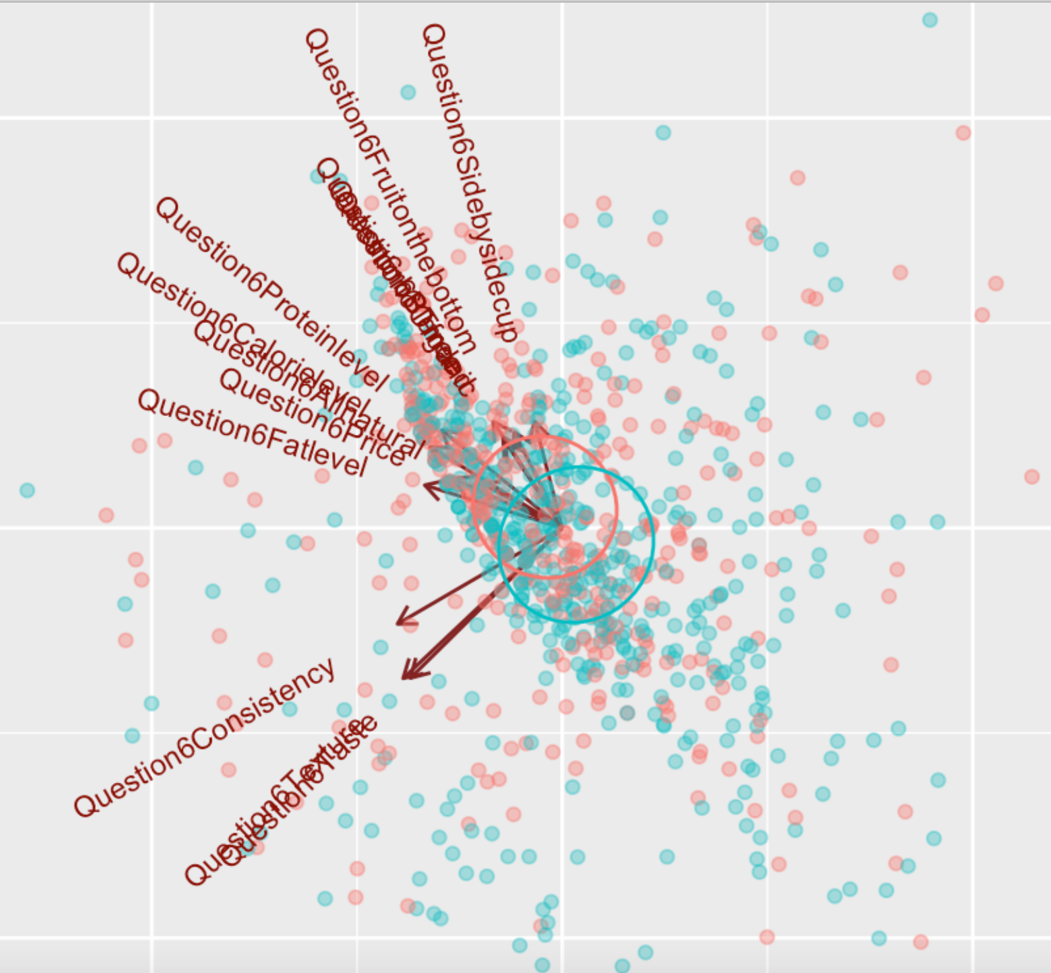
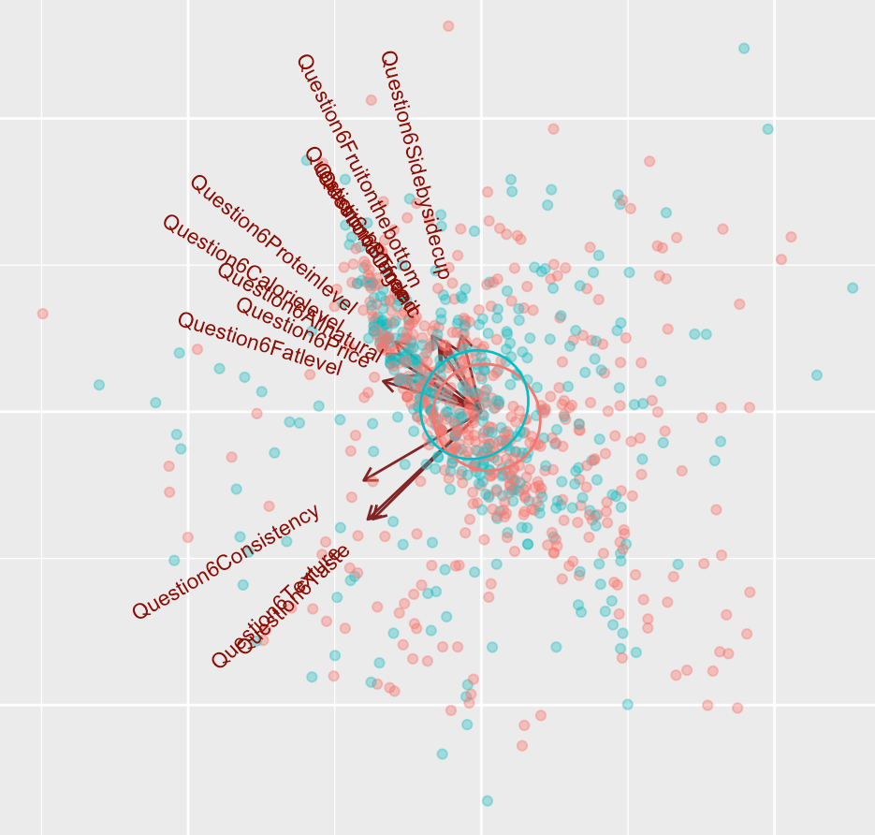
Appendix C - Brand Comparison：why chose certain brand
|
Groups:
No
yes
Fage
Chobani

Slide 12
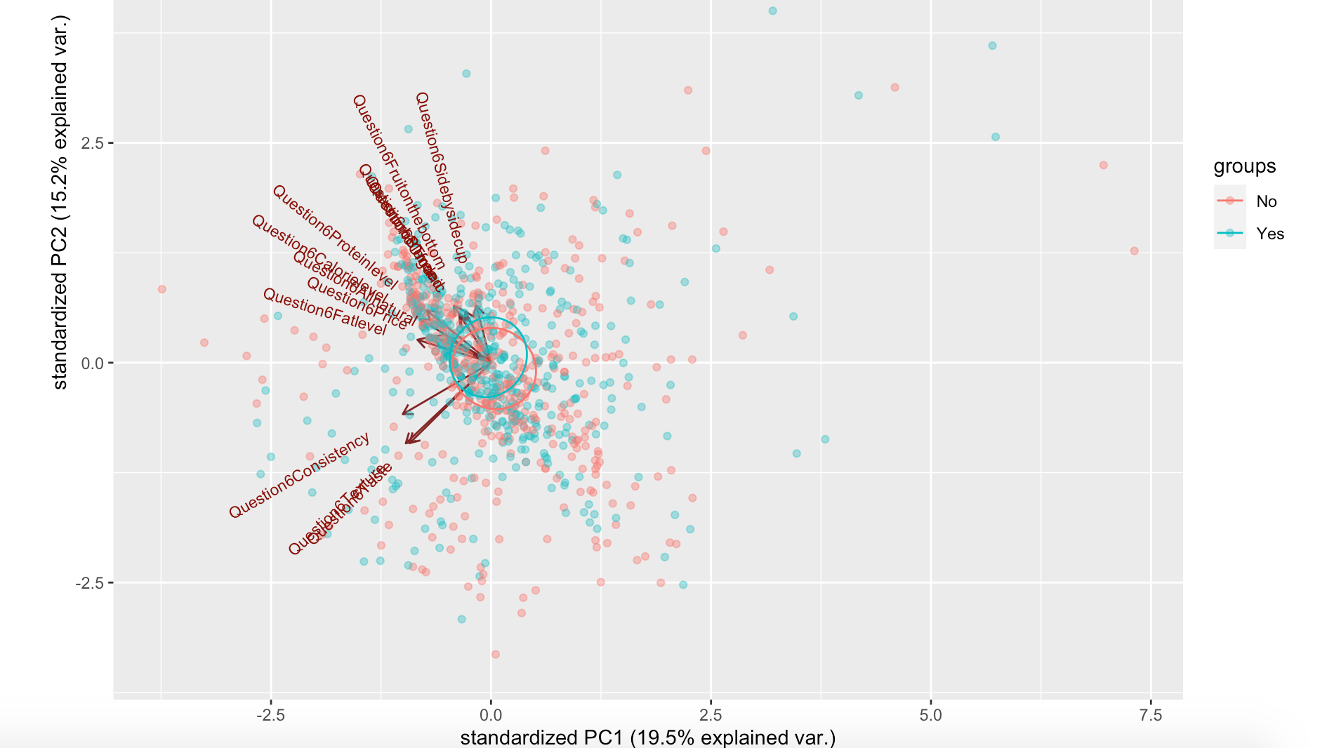
Appendix C - Brand Comparison：why chose certain brand
|
Oikos

Slide 13
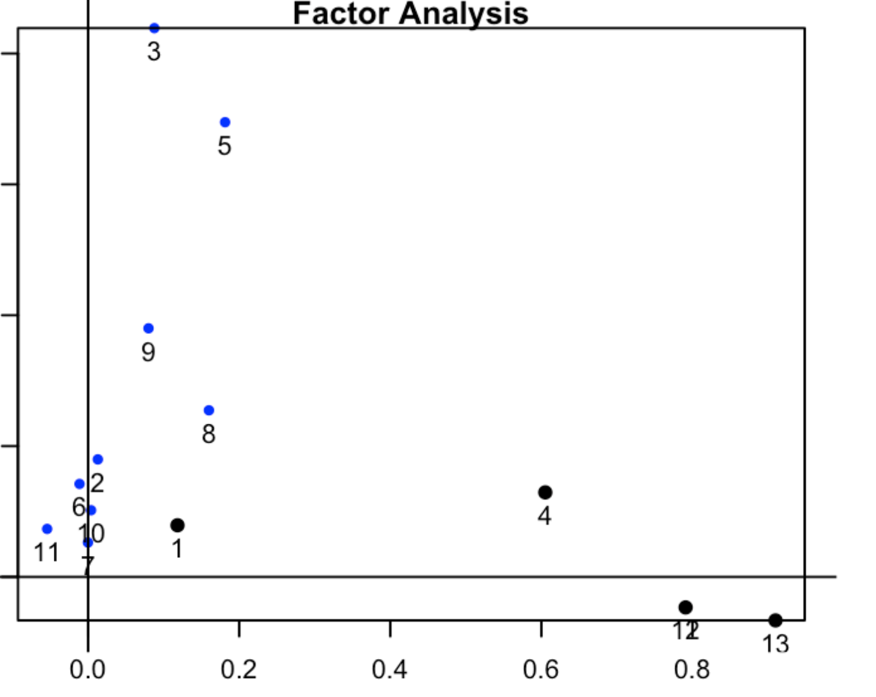
Appendix D - Factor Analysis for Question 6: attributes when purchasing Greek Yogurt
|
Oiko

Slide 14
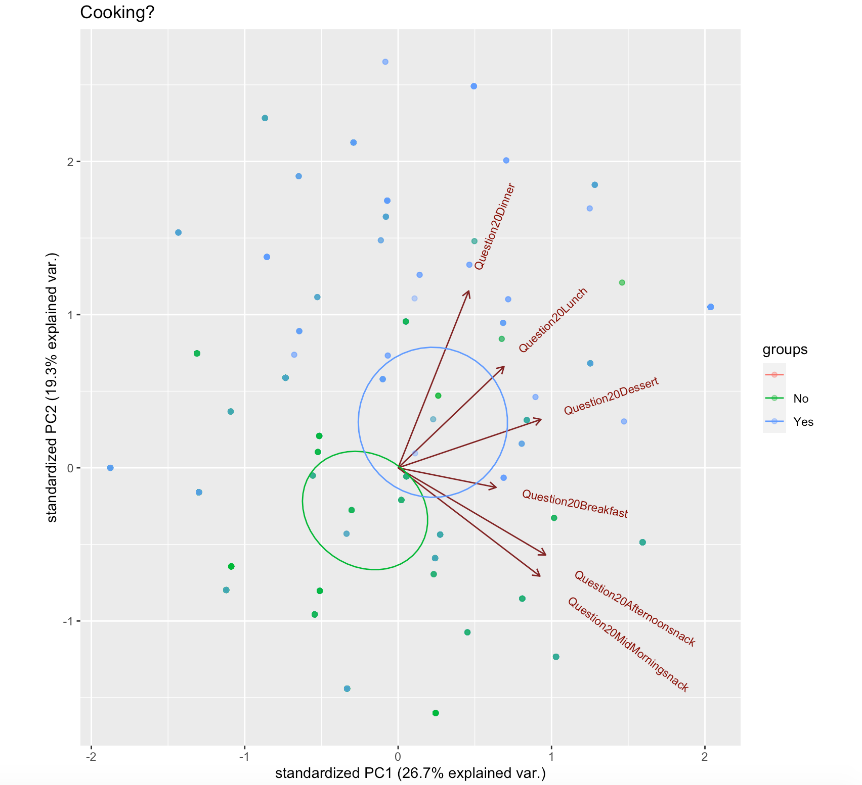
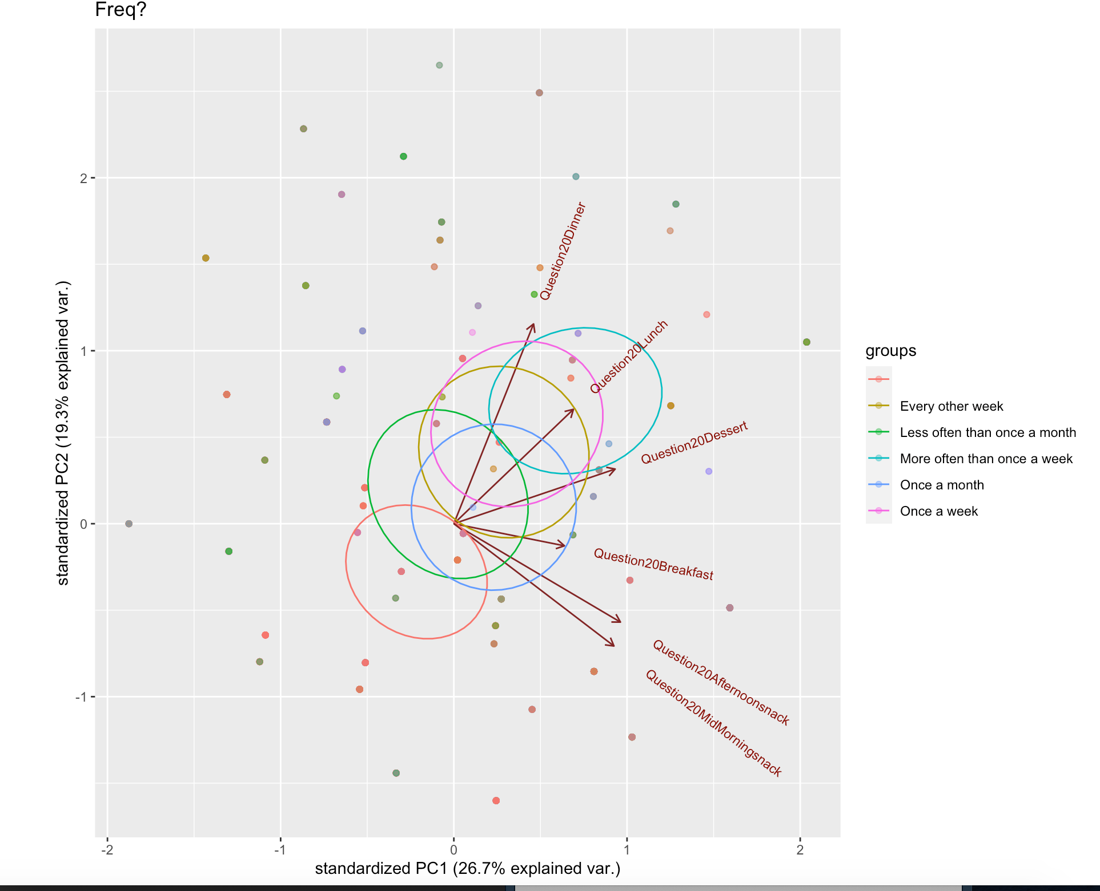
Appendix E - Greek Yogurt Occasions and Frequency
|

